Slide 1
MGT 506: Case 1-Walsh’s Juice Company
Group 4
Fatir Ihsan
Pranavi Jannu
Chanukya Bolli
Yasmin Kauser
Pruthvi Pamishetti

Slide 2
SUMMARY OF THE CASE
Walsh’s Juice Company produces products from unprocessed grape juice which are harvested at the three vineyards in New York,Ohio,and Pennsylvania. The products are processed in four processing plants in Virginia,Michigan,Tennessee,and Indiana.
Management requires a model that accounts for both the logistical and production-processing sides of this issue.

Slide 3
OBJECTIVE AND QUESTION
Objective :- To Minimize total costs,including the cost of transporting grape juice from the vineyards to the plants and the product processing costs.
How many tonnes of grape juice need to be transported from each vineyard to each processing plant?
How many tonnes of each product should be processed at each plant?

Slide 4
Model Description
Utilizing a linear programming model, the primary goal of our model is to minimize the overall total expenditure, encompassing both the transportation of grape juice from the vineyards to the plants and the costs associated with product processing.
This model was chosen due to its capacity to manage grape juice resources effectively, streamlining transportation from vineyards to plants and the subsequent product processing, while minimizing the expenses.
Linear programming models are widely used in supply chain management and production planning due to their ability to handle multiple constraints and objectives, making them a suitable choice for this scenario.
The linear programming model for Walsh’s Juice Company was created by establishing decision variables, formulating an objective function and defining a set of constraints.

Slide 5
Assumptions and Constraints
During a specific month the unprocessed grape juice available in the vineyards in NY, OH & PA are 1400, 1700 and 1100 tons respectively.
The monthly processing capacities for unprocessed grape juice at the plants in VA, MI, TN & IN are 1200, 1100, 1400 & 1400 tons respectively.
The company requires to process a total of 1200 tons of bottle juice, 900 tons of frozen concentrate & 700 tons of jelly across all 4 plants.
Unprocessed juice required per ton for processing
1 ton of frozen concentrate requires 2 tons of unprocessed juice.
1 ton of jelly requires 1.5 tons of unprocessed juice.
1 ton of bottled juice requires 1 ton of unprocessed juice.
The quantity of juice that was processed must be equal to the quantity that was transported.
The quantity of juice shipped must be less than or equal to the processing capacity of each plant
The processed quantities of products must equal their demand.
The quantity of juice transported from the vineyards must be less than or equal to the available supply of unprocessed juice at the plants.

Slide 6
Analysis and Results
Objective
Function
Minimize Cost = | Transportation Cost + Processing Cost
Transportation Cost = | 850xA1 + 720xA2 + 910xA3 + 750xA4
 | + 970xB1 + 790xB2 + 1050xB3 + 880xB4
 | + 900xC1 + 830xC2 + 780xC3 + 820xC4
Processing Cost = | 2100yP1 + 2350yP2 + 2200yP3 + 1900yP4
 | + 4100yQ1 + 4300yQ2 + 3950yQ3 + 3900yQ4
 | + 2600yR1 + 2300yR2 + 2500yR3 + 2800yR4
Decision Variables = x_{i},y_{j}
Transportation Cost ($/ton)
Vineyard | Plant
 | Virginia (1) | Michigan (2) | Tennessee (3) | Indiania (4)
New York (A) | 850 | 720 | 910 | 750
Pennsylvania (B) | 970 | 790 | 1050 | 880
Ohio (C) | 900 | 830 | 780 | 820
Processing Cost ($/ton)
Product | Plant
 | Virginia (1) | Michigan (2) | Tennessee (3) | Indiania (4)
Juice (P) | 2100 | 2350 | 2200 | 1900
Concentrate (Q) | 4100 | 4300 | 3950 | 3900
Jelly (R) | 2600 | 2300 | 2500 | 2800

Slide 7
Analysis and Results
Optimal Transportation Plan
Vineyard | Plant
 | Virginia | Michigan | Tennessee | Indiania | Total
New York | 0 | 0 | 0 | 1400 | 1400
Pennsylvania | 0 | 1100 | 0 | 0 | 1100
Ohio | 150 | 0 | 1400 | 0 | 1550
Total | 150 | 1100 | 1400 | 1400
Transportation Cost = $3,146,000
Juice required per ton
Juice | 1
Concentrate | 2
Jelly | 1.5
Optimal Processing Plan
Product | Plant
 | Virginia | Michigan | Tennessee | Indiania | Total
Juice | 0 | 0 | 0 | 1200 | 1200
Concentrate | 75 | 25 | 700 | 100 | 900
Jelly | 0 | 700 | 0 | 0 | 700
Juice Required | 150 | 1100 | 1400 | 1400
Processing Cost = $7,460,000
Min Total Cost = $3,146,000 + $7,460,000 = $10,606,000

Slide 8
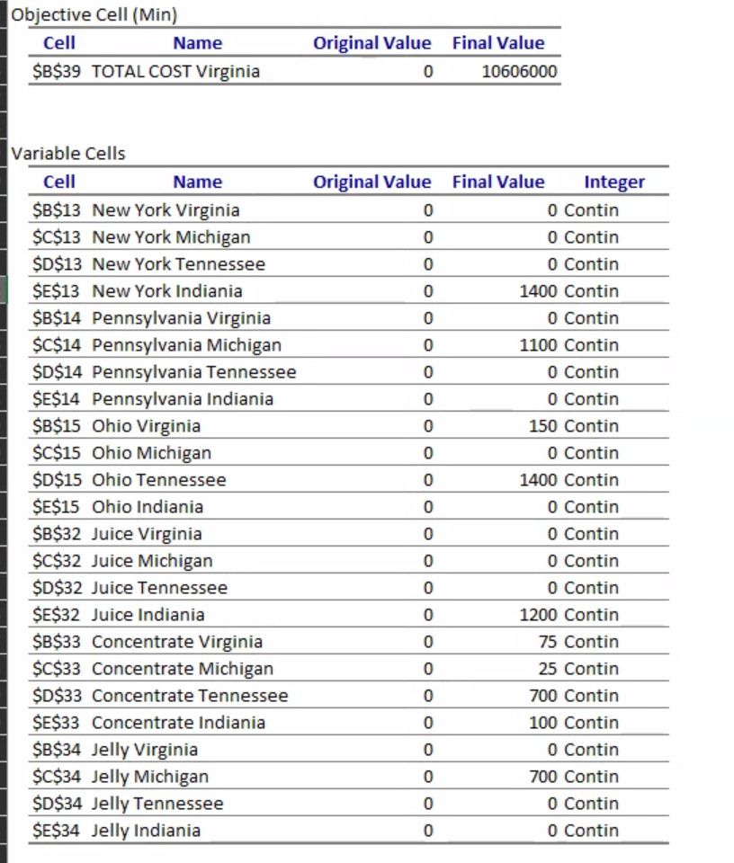
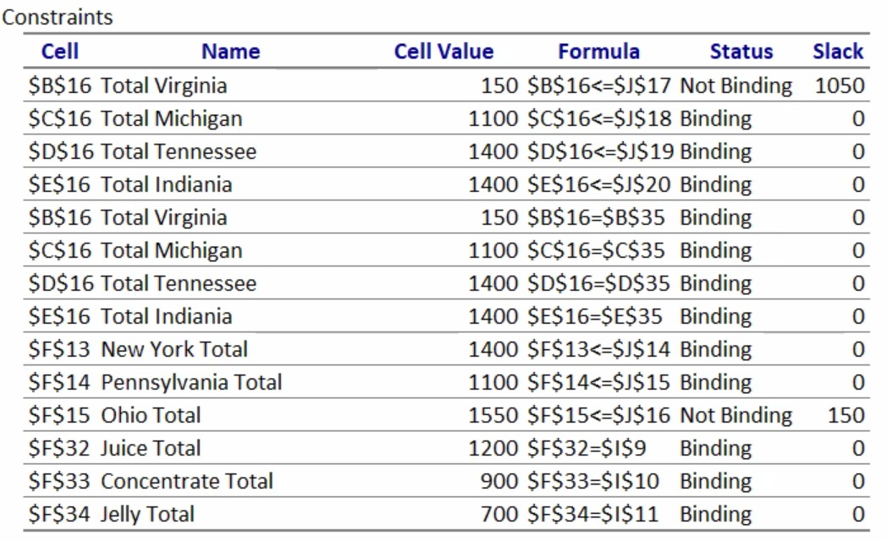
Answer Report
Plant in Virginia had a processing capacity of 1200 tons of juice, however there is a slack of 1050
Ohio Vineyard supplies only 1550 tons out of the available 1700 tons of unprocessed juice, therefore a slack of 150

Slide 9
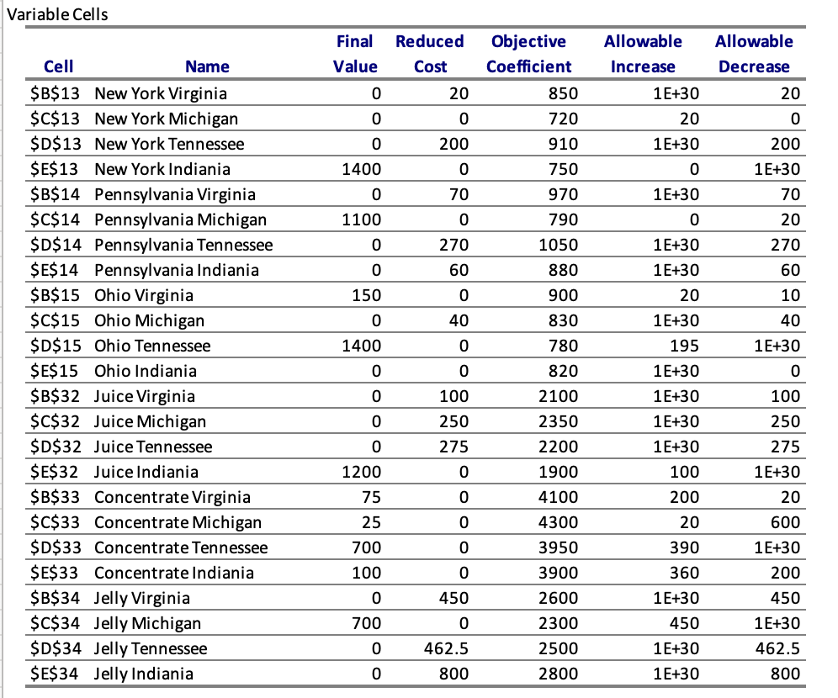
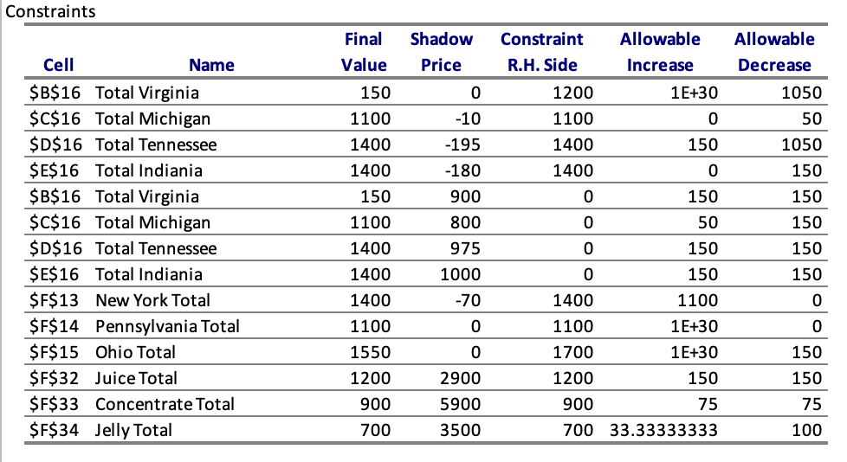
Sensitivity Report

Slide 10
Conclusion
To conclude, based on the solution we got from the excel solver the transportation cost was $3,146,000 and the processing cost was $7,460,000 which is significantly higher that the transportation cost.
By combining both the transportation cost and the processing cost we get the total cost of $10,606,000.
So based on the optimal solution we got, we can even further optimize, by regularly reviewing costs,routes and processing methods which can lead to significant savings and more efficient operations.

Slide 11
Recommendations
Maximize Indiana's Juice Production:
Indiana's juice processing cost is $1900/ton.
Prioritize allocating more juice to this plant to get closer to its processing capacity of 1,400 tons.
Route More Juice from Ohio to Tennessee:
Transporting juice from Ohio to Tennessee costs $780/ton.
Prioritize maximizing this route to ensure close to the 1,400 tons capacity of Tennessee.
Adjust Pennsylvania's Distribution:
Pennsylvania sends juice to Michigan at a cost of $790/ton with an allowable decrease of $20.
Explore other distribution routes if transportation costs increase.

Slide 12
Re-evaluate Concentrate Production in Michigan:
Michigan's concentrate processing cost can decrease by $600 before it affects the optimal solution.
Reassess the decision to increase concentrate processing in Michigan even if costs drop, given the current 25 tons is optimal.
Capitalize on Ohio's Output Flexibility:
Ohio has a potential slack of 150 tons.
Use this extra output to diversify supplies or address sudden demand spikes.
Monitor Production at Binding Plants:
Michigan, Tennessee, and Indiana plants are all operating at their full capacities.
Regularly review these plants and ensure efficient utilization. Consider potential expansion if demand grows.

